Slide 1
Engage’20 mentorship program
Project: Entertain the Crew
Team: Perseverance-20

Slide 2

Team: PERSEVERANCE-20
Engaging the Crew by Using Minimax algorithm to build an unbeatable Tic Tac Toe game powered by AI.
PERSEVERANCE:
meaning the ability to keep doing something in spite of obstacles. We wanted to do justice by our team’s name and here we are ☺
As the program revolved around MARS.
(THE MARS COLONIZATION PROGRAM) we did some research and this 30th July, Perseverance rover is going on mars to do wonders . We also wanted to do wonders with our project.
OSHIN SAINI
(team member)
You can find me at oshinsaini
SIDDHI MISHRA
(team member)
You can find me at siddhimishra
2

Slide 3

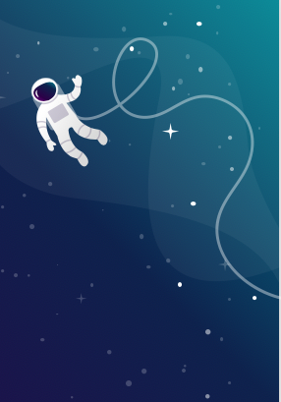


Project Goals:
This project is made under the Microsoft Mars colonization program organized by Microsoft.
It is a game website that provides tic tac toe games with additional features. This project is made under consideration of providing an entertainment platform to our crew members during our Mars colonization program. We have designed different versions of the game using terminology level 1/level 2/ unbeatable etc. There are 6 different versions of the same game we are providing on our website. The main highlight of this project is we have developed a new class of a game using the same set of rules of tic-tac-toe but have a 3D version with some additional features and rules.
In this project our goal is to take traditional tic-tac-toe to another level. For this purpose we are aimed to implement some currently used algorithms to shift the 2 player mode to one player by making one move to be played by computer. In our second phase of development we aimed to make the game more interesting and increase the difficulty level of game by proving some additional features and in last phase, we train our computer to make move in our new design game with different level of smartness.

Slide 4
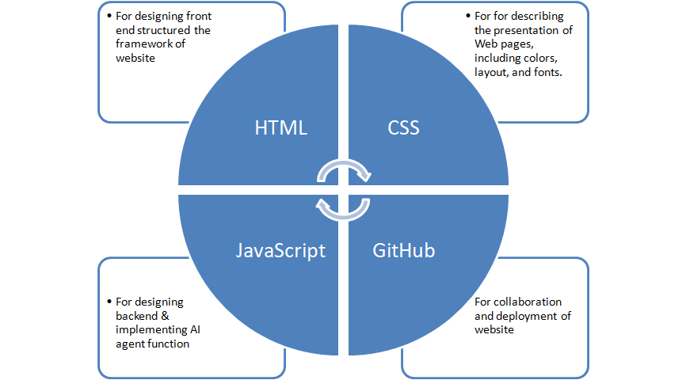
Tech Stack
Frontend: HTML/ CSS
Backend: JavaScript/ jQuery
Platform: GitHub/ GitHub Pages

Slide 5
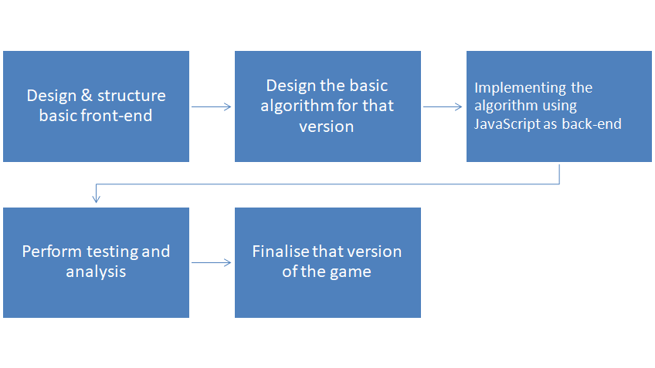

workflow for each version of the game
Our team has decided to work on each and every version of came in phase-wise and for each version the workflow will be like following:
We are using the same workflow for all the versions of a game and in the end, we will integrate all the versions on a website and deploy it using GitHub.

Slide 6
PHASES
Traditional Phase
Classical Phase
Integration Phase
1) with two-player mode.
2) level 1 of the game where the computer is able to make moves instead of one player.
3)level 2 in which the computer trained using some agent function to make smart moves.
4) In the last version of the game, we are using the minimax algorithm which will convert and implement according to the functional requirement of our base game to make computer move unbeatable.
1)The first task is to design and develop a 2 player version of the game and verify whether it follows all sets of rules of the traditional tic tac Toe game.
2)now analyze the two-player mode and change this version to make computer move possible.
3) Smarten the computer move using some basic AI function to develop the two versions of the game version called level 1 and level 2 respectively.
4)for an unbeatable version, by taking a reference of the traditional minimax algorithm and developed an unbeatable version of our designed game.
After the traditional and classical phase we have integration phase.
1) Here we structure and design our base page where all other levels/versions of a game can be called. The aim to design the base page is to integrate all the versions of the game on a single platform.
2) do work on lookup and beautification of websites.
3) deploy the website using the GitHub platform.
4) test our website using different browsers and test cases.

Slide 7
TIC-TAC-TOE
TIC-TAC-TOE
( Computer/ 2Player)
2D tic-tac-toe
3D tic-tac-toe
Level-1
(Html, CSS, JavaScript)
Level-2
(Html, CSS)
Beat Me If you Can!
(Html, CSS, JavaScript)
Level-1
(Html, CSS, JavaScript)
Level-2
(Html, CSS)
Beat Me If you Can!
(Html, CSS, JavaScript)

Slide 8
Unique concept
It’s a next level of tic-tac-toe, 3D TIC-TAC-TOE in which user is allowed to play same tic-tac-toe on 3D plane against computer which enhances the difficulty level of the game.

Slide 9
TABLE OF CONTENTS
About Tic Tac Toe
Minimax algorithm
Unbeatable Tic Tac Toe AI
Place your screenshot here

Slide 10
ABOUT
Tic-tac-toe (also known as noughts and crosses or Xs and Os) is a paper-and-pencil game for two players, X and O, who take turns marking the spaces in a 3×3 grid. The player who succeeds in placing three of their marks in a horizontal, vertical, or diagonal row wins the game.
In order to solve Tic Tac Toe, we need to go deeper than just to think about it as a game where two players place X’s and O’s on the board. Formally speaking, Tic Tac Toe is a zero-sum and perfect information game. It means that each participant’s gain is equal to the other participants’ losses and we know everything about the current game state.

Slide 11
MINIMAX ALGORITHM:
Minimax is a kind of backtracking algorithm that is used in decision making and game theory to find the optimal move for a player, assuming that your opponent also plays optimally.
Minimax is a recursive algorithm which is used to choose an optimal move for a player assuming that the opponent is also playing optimally. As its name suggests, its goal is to minimize the maximum loss (minimize the worst case scenario).

Slide 12
“
You can think of the algorithm as a representation of the human thought process of saying, “OK, if I make this move, then my opponent can only make two moves, and each of those would let me win. So this is the right move to make.”

Slide 13
Unbeatable Tic Tac Toe AI
Let’s look at the following board state. We will try to solve it as X.
How would you solve it?
I guess that would you think that the best move in such a scenario would be to place an X in the middle of the board and win the game.
And you would be correct, but is this the only winning solution for X? How to derive this solution?
In order to determine this, let’s draw a tree of all possible board states.

Slide 14
As you can see above, starting from the initial state 0.0, we have 3 possibilities (1.0, 1.1, 1.2). 1.0 gives us a win (+1), but let’s explore other paths as well.
1.1 gives our opponent 2 possibilities (2.0, 2.1). 2.0 is a winning state for our opponent, so it’s a losing state for us (-1). 2.1 gives only one possibility 3.0 in which we are winning (+1).
1.2 gives our opponent 2 possibilities (2.2, 2.3). 2.2 is a winning state for our opponent, so it’s a losing state for us (-1). 2.3 gives only one possibility 3.1 in which we are winning (+1).
Okay, but how can we interpret this?

Slide 15
Let’s start from the terminal states at the bottom and calculate the minimax scores.
At the depth 3 we are maximizing, so we are propagating +1 scores to the previous moves at the depth 2.
At the depth 2 we are minimizing so we are propagating -1 scores to the previous moves at the depth 1.
At the depth 1 we are maximizing so we are propagating +1 to the previous move at the depth 0.
Ultimately at the depth 0, where we actually are, we should pick the move associated with the +1 score we’ve ended up with.
Tic Tac Toe AI would decide to go to the 1.0 node and win the game.
Our Tic Tac Toe AI performs such simulations for every move thus making itself an unbeatable opponent.

Slide 16
But what makes it unbeatable?
Due to the relatively small state space (3⁹ = 196839 possible board combinations), it can easily search the whole game tree for an optimal solution, treating the game as a fully deterministic environment.
On the other hand, chess for example has an enormously large state space of ~10¹²⁰ possibilities.
This is a figure far greater than the
number of atoms in the observable universe.
With such extensive search spaces, we can still use Minimax algorithm, but we have to remember to limit the depth of our search. Otherwise, we can end up computing results for a very long time or even forever.
Long story short, the smaller the state space, the better results we can achieve with the Minimax algorithm.

Slide 17
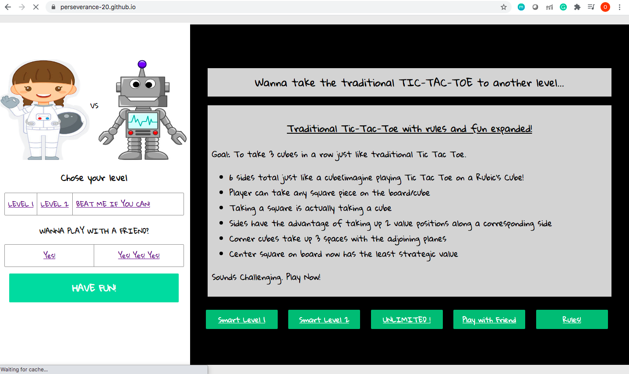
Hosted using GitHub Pages
3D Levels
2D Levels
Easy
Medium
Unbeatable
2Player
Understanding the game better!

Slide 18
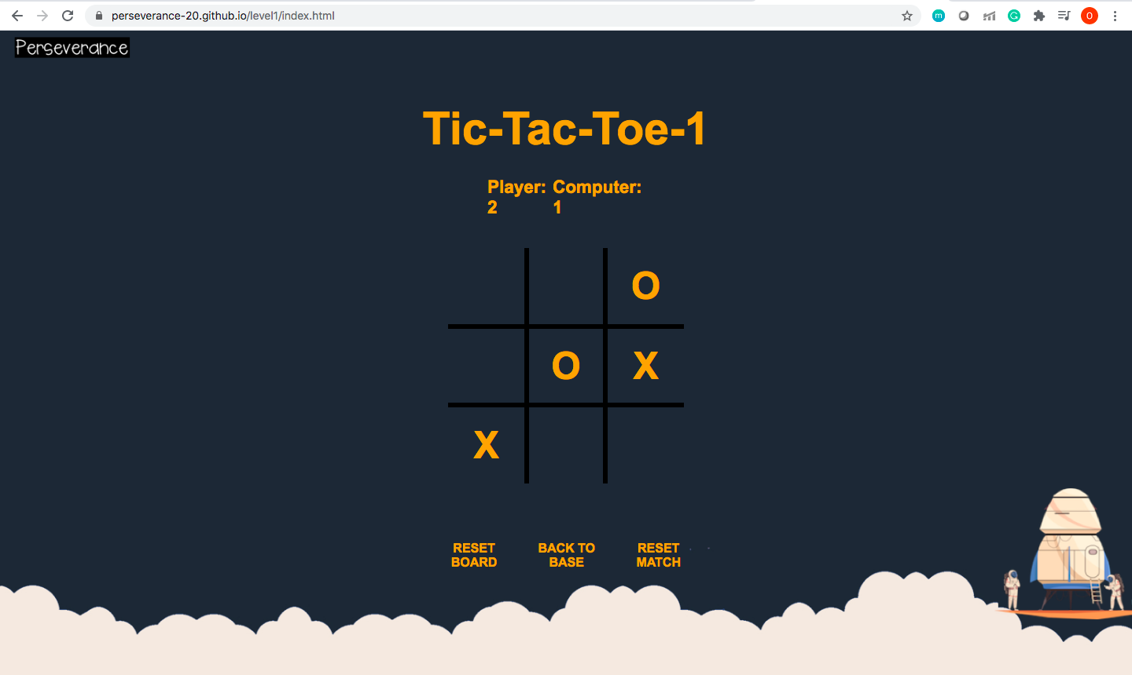
Hosted using GitHub Pages
Level: EASY
Computer is going line/position wise.
Its checking:
1)Win
2)Lose
3)Turn
2D
TIC-TAC-TOE
Resets Board
Back to Home page
Resets the score of the entire game
TOOLS: HTML, CSS, JAVASCRIPT

Slide 19
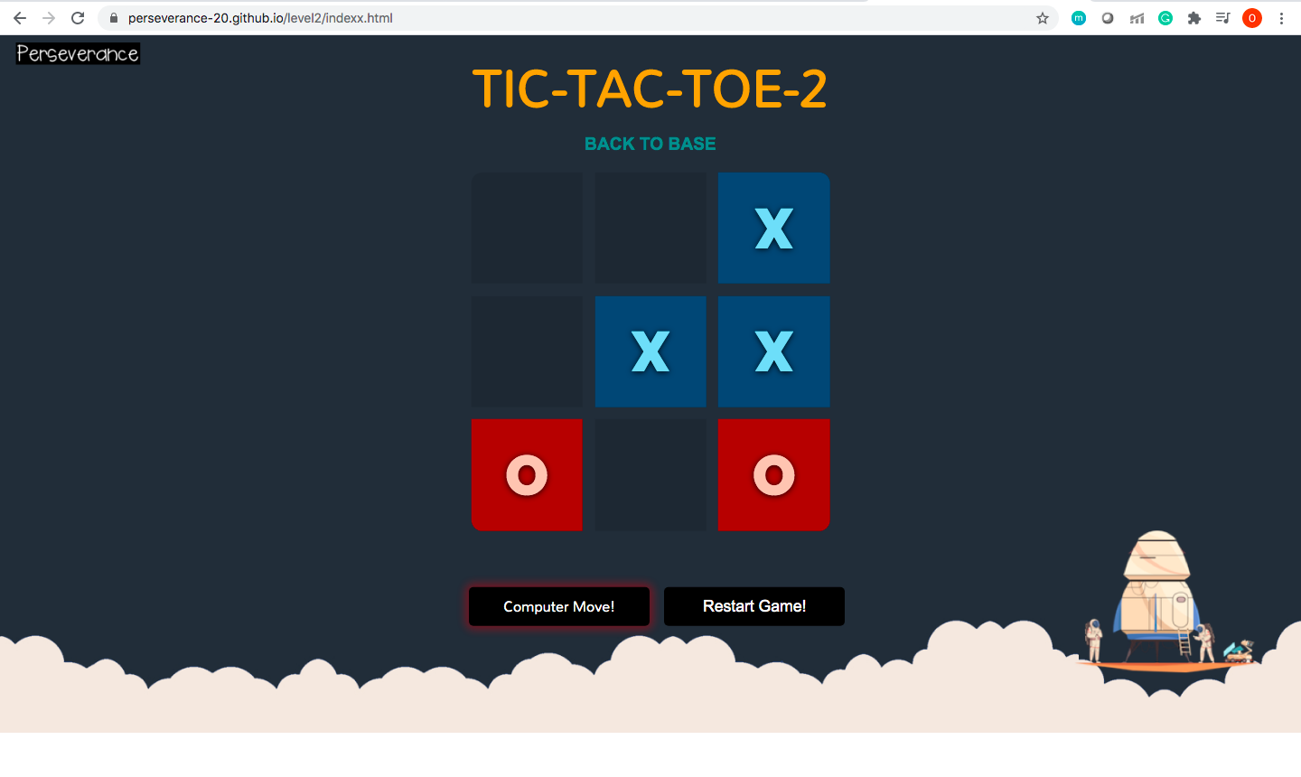
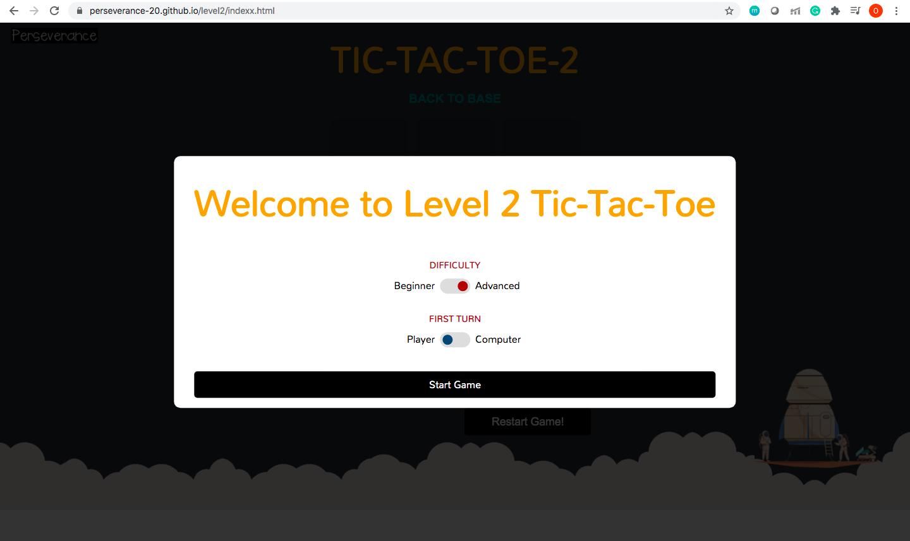
2D TIC-TAC-TOE
Choosing between options
Level: MEDIUM
Computer is moving randomly.
Its checking:
1)Win
2)Lose
3)Random Turn
Special Feature:
Made using only CSS
[no JavaScript]
TOOLS: HTML, CSS

Slide 20
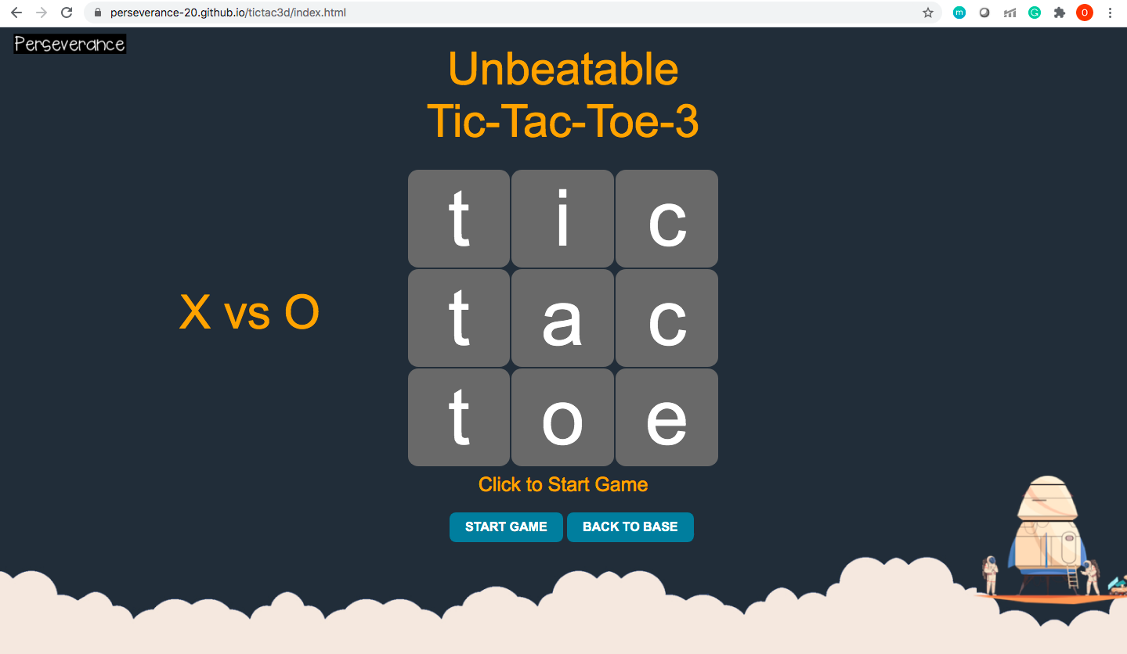
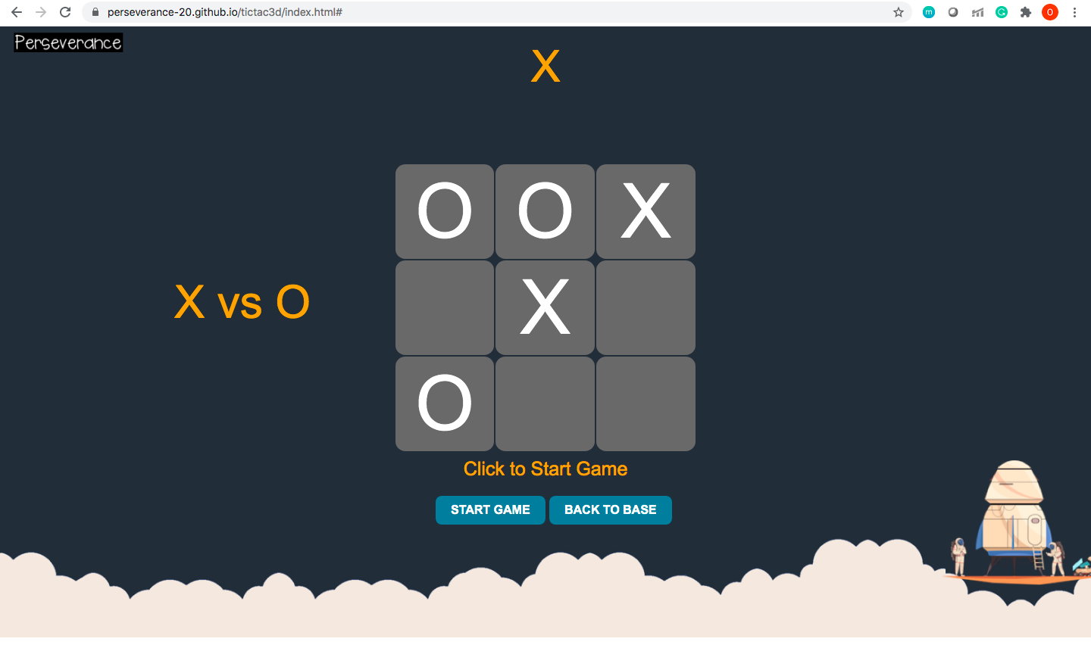
2D UNBEATABLE TIC-TAC-TOE
Choosing between options
Level: UNBEATABLE
Computer is moving optimized moves using AI.
Algo used: MINIMAX
Special Feature:
Added sound effects
TOOLS: HTML, CSS, JAVASCRIPT

Slide 21
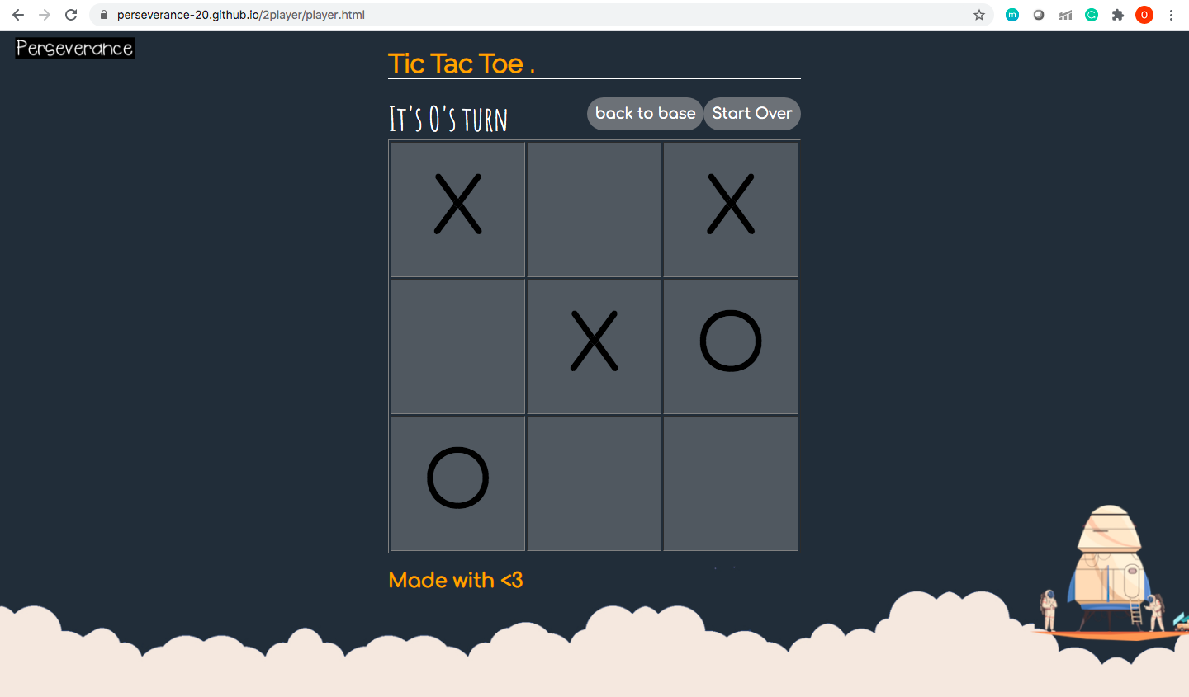
Hosted using GitHub Pages
Resets Board
2D
TIC-TAC-TOE
Back to Home page
A FUN 2-PLAYER TIC TAC TOE
TOOLS: HTML, CSS, JAVASCRIPT

Slide 22
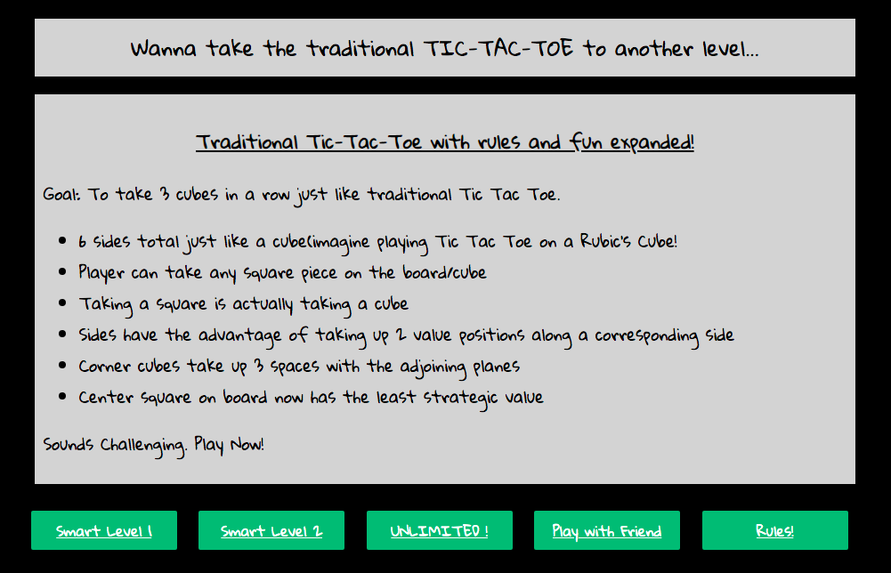
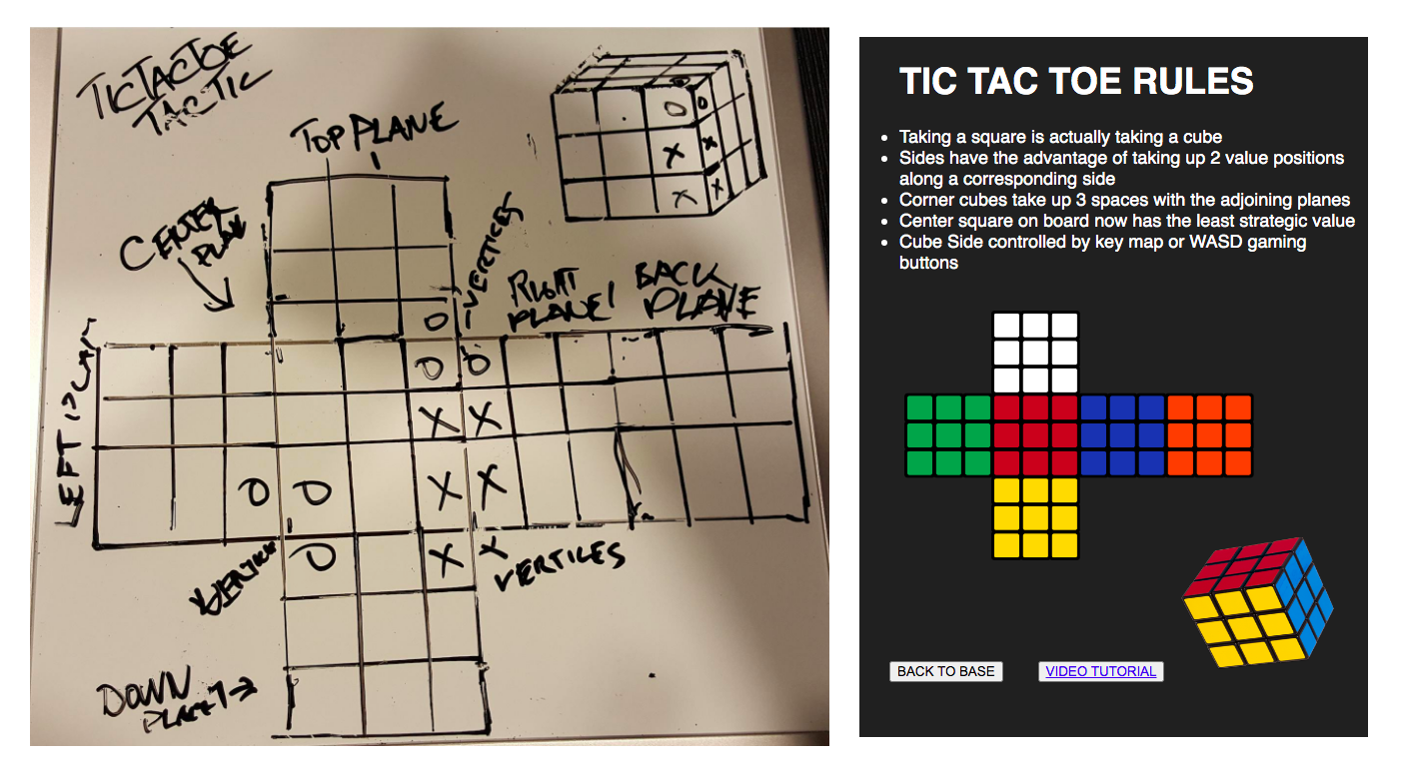
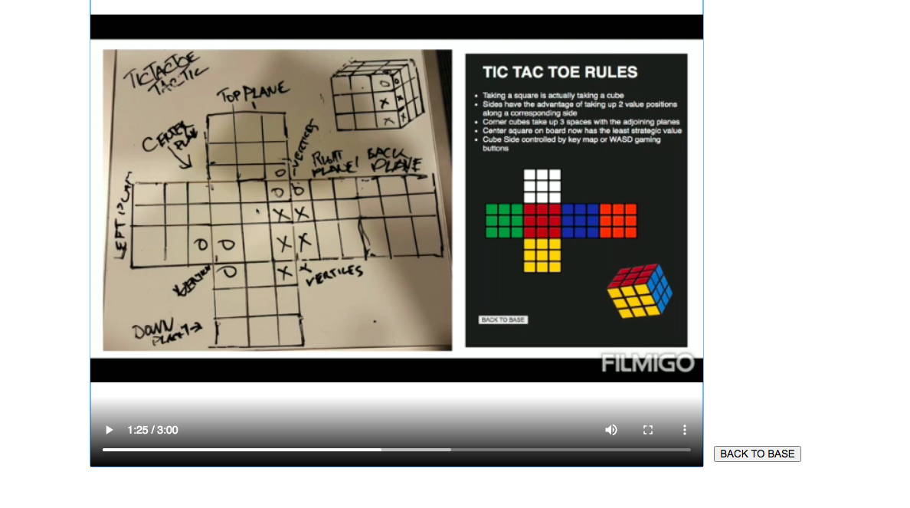
3D TIC-TAC-TOE RULES
EXPLAINED 3D TIC-TAC-TOE RULES USING:
1)Detailed Explanation
2)Images and Diagrams
3)Video Tutorial
4)Live Demo

Slide 23
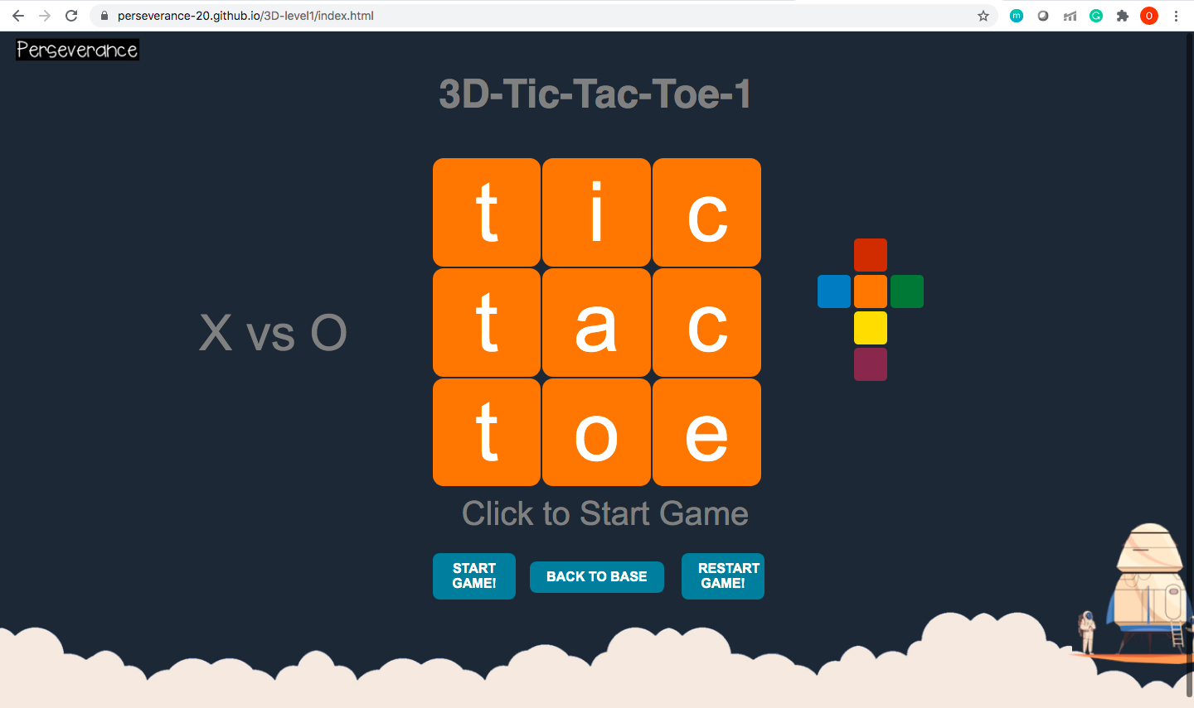
3D TIC-TAC-TOE LEVEL-1
Choosing between options
Level: EASY
Computer is taking moves using AI but not smartly.
Algo used: Line /position wise on six different planes while checking for win/lose condition
Special Feature:
6 diff planes
Added sound effects
TOOLS: HTML, CSS, JAVASCRIPT

Slide 24

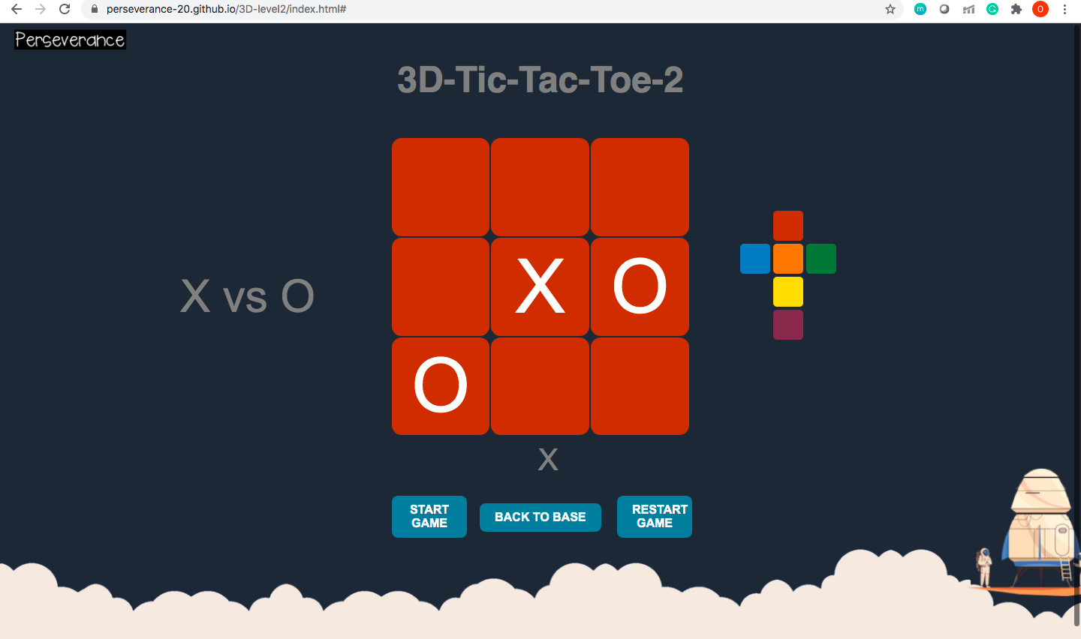
3D TIC-TAC-TOE- level-2
Choosing between options
Level: MEDIUM
Computer is taking moves using AI and is trying to play smartly.
Algo used: Random moves on six different planes while checking for win/lose condition
Special Feature:
6 diff planes
Added sound effects
TOOLS: HTML, CSS, JAVASCRIPT

Slide 25
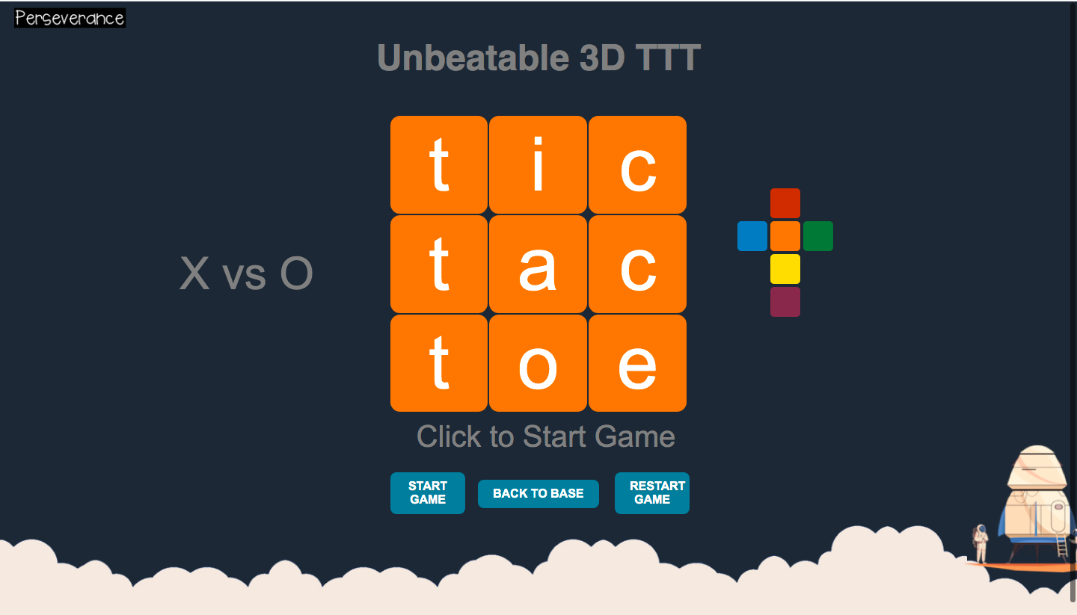
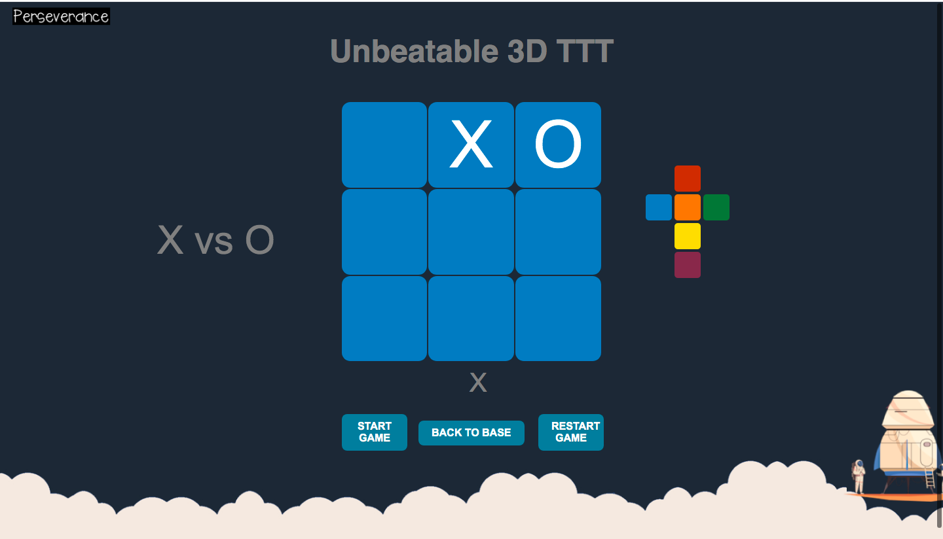
3D UNBEATABLE TIC-TAC-TOE
Choosing between options
Level: UNBEATABLE
Computer is taking smart and optimized moves using AI
It’s playing intelligently.
Algo used: MINIMAX ALGO
moves on six different planes.
Special Feature:
6 diff planes
Added sound effects
TOOLS: HTML, CSS, JAVASCRIPT

Slide 26
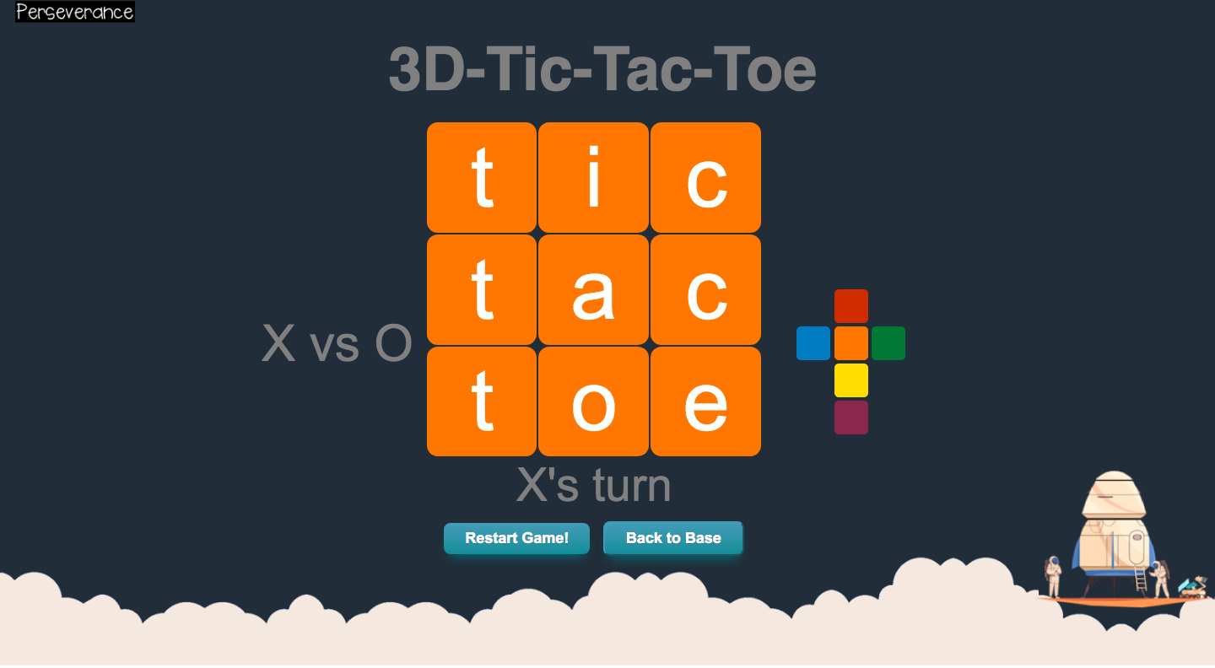
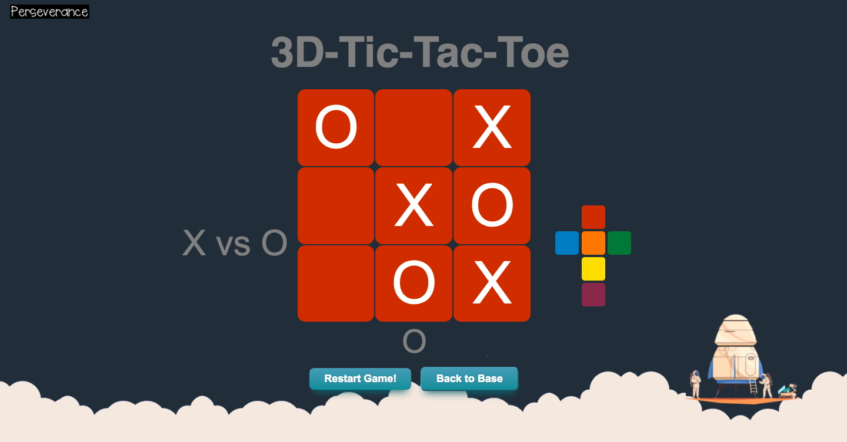
3D TIC-TAC-TOE. 2-player
Choosing between options
Level: 2-PLAYER
2-player can play the game.
Algo used: moves on six different planes.
Special Feature:
6 diff planes
Added sound effects
TOOLS: HTML, CSS, JAVASCRIPT

Slide 27
FUNCTIONALITY
i) Made a game algorithm which allows the user to play 2d Tic-tac-toe, in two-player mode using basic algorithms.
ii) Design the algorithm to make a computer to move in place of one player. We have done it in three Versions:
1)In the first version, we have used simple logic of move using JavaScript as backend & HTML/CSS in its frontend (i.e. making random moves) for our computer as level 1 of the game.
2)In the second version, we have designed a CSS based computer move which makes our algorithm unique and different & difficult from level 1.
3) In the third version, we have used the popular “minimax algorithm” to implement our level 3 of the game. We have made some functions to get board value and change the index using the id of the table; here we use JavaScript for backend development & HTML/CSS for frontend.
iii) Design the next level of the game, we have taken reference from level 3 of tic-tac-toe to design the six faces using a table and providing these table id to the backend to render the changes during the game. We have made a board as a variable to define all the faces of cubes and do change in it with help of bS array which enables the board to follow the rule of the game during the change in values of a plane.
1) In the next step, we design an algorithm to make the computer move just seeing win/lose condition and move sequentially and implement using JavaScript. Here our computer move is made by calling the best move function.
2) Increasing the level of difficulty we made our computer to move in a random manner using random ()/random. Fixed () etc. and made level 2 of the project.
3) In our final version of our project we have made an algorithm that makes our computer to make smart moves in our designed game. Here we take analysis and then taking reference to the “minimax algorithm” we have developed our final AI algorithm & implement using JavaScript. For the completion of this phase, we have to undergo multiple testing & debugging phases to make our algorithm unbeatable.

Slide 28
VIEW OUR PROJECT:
GITHUB: https://github.com/perseverance-20/perseverance-20.github.io
WEBSITE: https://perseverance-20.github.io/
VIEW PROJECT

Slide 29
THANK YOU!

